Slide 1


Slide 2


Android Development

Slide 3

Course objectives
Android Development
By completing this course you will be able to:
  Develop user interfaces

Slide 4


Course plan
Android Development
  Layouts
  Views
  Events
  Binding Datas

Slide 5
LAYOUTS
Android Development

Slide 6

Layouts
Presentation
A layout is a ViewGroup which help us to position our views
A layout is also a view
A layout can contain other layouts
Common layouts provide by the SDK are :
  LinearLayout
  RelativeLayout
  FrameLayout
  TableLayout
We’re going to see only the first one
Notes:
[Title of the course]
Nov 8, 2008
Copyright © 2004-2005 NameOfTheOrganization. All rights reserved.
6

Slide 7
Layouts
Presentation FrameLayout
All layouts are ViewGroup objects
  Contain View and ViewGroup objects
FrameLayout is the most basic layout
Child Views are displayed as a stack
  Multiple child Views may be added
    Child Views added later obscure those below
  Fixed position at upper left of frame
The frame is sized to the size of the largest child
  Visible or not
Notes:
[Title of the course]
Nov 8, 2008
Copyright © 2004-2005 NameOfTheOrganization. All rights reserved.
7

Slide 8

Layouts
Presentation TableLayout
Provides a table of rows and columns
Defined by declaring rows in the table
  Similar to HTML tables
  Rows do not all have to have the same number of cells
Each row is identified with a <TableRow> element
There is no column element
  Each View within the row is interpreted as a column
Notes:
[Title of the course]
Nov 8, 2008
Copyright © 2004-2005 NameOfTheOrganization. All rights reserved.
8

Slide 9
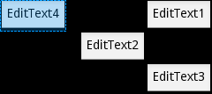
Layouts
Presentation RelativeLayout
Used for complex layouts
  Preferred over using multiple nested LinearLayouts
Child Views may be positioned relative to each other
  layout_alignRight, layout_alignBelow, etc.
Or relative to the parent layout
  layout_alignParentRight, layout_alignParentBelow, etc.
Notes:
[Title of the course]
Nov 8, 2008
Copyright © 2004-2005 NameOfTheOrganization. All rights reserved.
9

Slide 10
Layouts
Presentation LinearLayout
Creates a row or column
  Aligned horizontally or vertically
Children may be given weight
  Controls how otherwise unallocated space is used
  Space is allocated in proportion to child layout_weight value
    If multiple with highest value: space equally shared
  Children may be assigned a gravity value
    top, bottom, left, right, center_vertical, center_horizontal, etc.
  Controls position within the cell of the layout
Notes:
[Title of the course]
Nov 8, 2008
Copyright © 2004-2005 NameOfTheOrganization. All rights reserved.
10

Slide 11

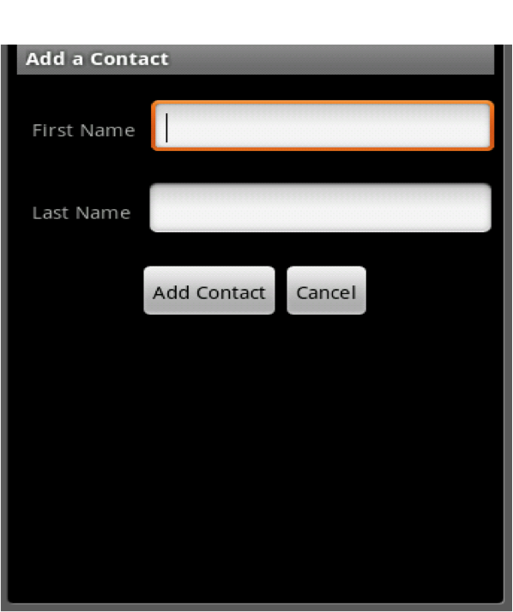
Layouts
LinearLayout
A Layout that arranges its children in a single column or a single row
This layout is the more use in Android development
  It can almost do everything others can do
    With nesting layout !
Notes:
[Title of the course]
Nov 8, 2008
Copyright © 2004-2005 NameOfTheOrganization. All rights reserved.
11

Slide 12

Layouts
LinearLayout : Component Size
The size of its components can be define with :
  In XML with layout_width and layout_height attributes
  In Java with a LayoutParams object
  Their values may be a dimension or one of the special constants :
MATCH_PARENT or WRAP_CONTENT
<TextView
android:layout_width="wrap_content"
android:layout_height=”10px"
/>
Notes:
[Title of the course]
Nov 8, 2008
Copyright © 2004-2005 NameOfTheOrganization. All rights reserved.
12

Slide 13
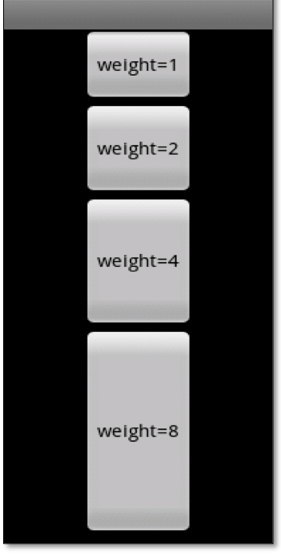
Layouts
LinearLayout : Weight
Defined how views on the same row share the layout size
Useful when you want several views share all the screen
  Example :
<Button
android:layout_width="wrap_content"
android:layout_height=”wrap_content”
android:layout_weight=”2”
android:layout_text=”weight=2"
/>
Notes:
[Title of the course]
Nov 8, 2008
Copyright © 2004-2005 NameOfTheOrganization. All rights reserved.
13

Slide 14
Layouts
LinearLayout : Gravity
Specify how to align the text by the view's x- and/or y-axis when the content is smaller than the view
Must be one or more (separated by '|') of the Gravity class constant values :
  LEFT / RIGHT
  TOP / BOTTOM
  CENTER
  …
<TextView
android:layout_width="match_parent"
android:layout_height="match_parent"
android:gravity=”top|right"
/>
Notes:
[Title of the course]
Nov 8, 2008
Copyright © 2004-2005 NameOfTheOrganization. All rights reserved.
14

Slide 15

Layouts
LinearLayout : Padding
By default, components are tightened each other
You can define space between them thanks to padding !
Padding is defined as space between the edges of the view and the view's content
Value in pixels
Five padding attributes exist :
    padding
    paddingLeft
    paddingRight
    paddingTop
    paddingBottom
Notes:
[Title of the course]
Nov 8, 2008
Copyright © 2004-2005 NameOfTheOrganization. All rights reserved.
15

Slide 16
Layouts
LinearLayout : Padding
XML example :
Java example :
<TextView
android:layout_width="match_parent"
android:layout_height="match_parent"
android:padding=”20px"
/>
EditText txtFirstName = ... ;
// left, top, right, bottom
txtFirstName.setPadding(20, 30, 10, 20);
Notes:
[Title of the course]
Nov 8, 2008
Copyright © 2004-2005 NameOfTheOrganization. All rights reserved.
16

Slide 17
Views
Android Development

Slide 18
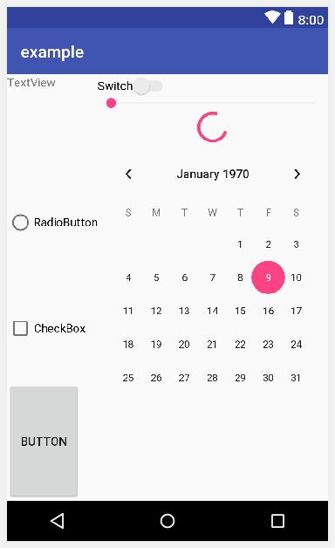
Views
Presentation
Android SDK propose many common components :
  TextView
  EditText
  AutoCompleteTextView
  RadioButton
  CheckBox
  Spinner
  RatingBar
  Button
  …
We’re going to see them.
Notes:
[Title of the course]
Nov 8, 2008
Copyright © 2004-2005 NameOfTheOrganization. All rights reserved.
18

Slide 19
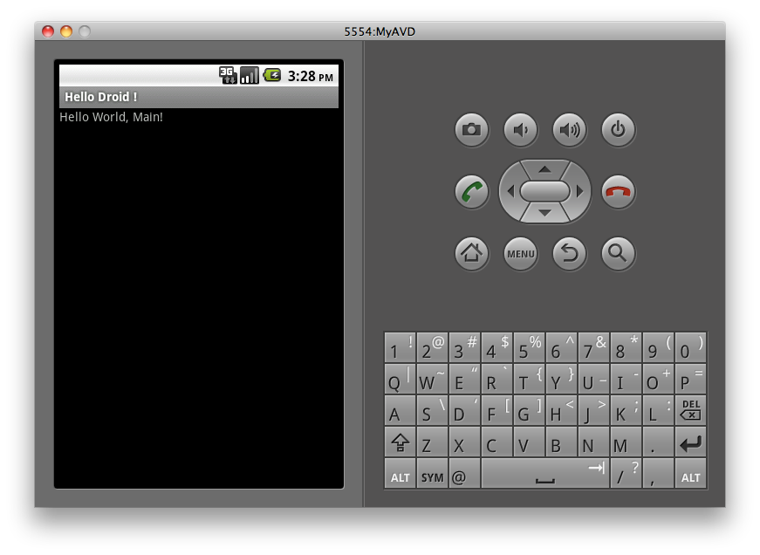
Views
TextView
Displays text to the user
Can be editable
  But disable by default
<TextView
android:layout_width="match_parent"
android:layout_height="match_parent"
android:gravity=”top|right"
/>
Notes:
[Title of the course]
Nov 8, 2008
Copyright © 2004-2005 NameOfTheOrganization. All rights reserved.
19

Slide 20
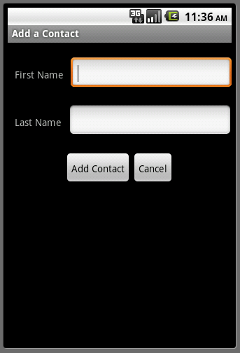
Views
EditText
EditText is a subclass of TextView
  Editable by default !
<EditText
android:layout_width="wrap_content"
android:layout_height="wrap_content"
android:id="@+id/first_name”
/>
Notes:
[Title of the course]
Nov 8, 2008
Copyright © 2004-2005 NameOfTheOrganization. All rights reserved.
20

Slide 21
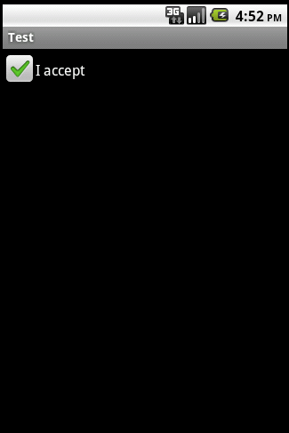
Views
CheckBox
A check box is a two-states button that can be either checked or unchecked
<CheckBox
android:id="@+id/checkbox”
android:layout_width="wrap_content”
android:layout_height="wrap_content”
android:text="check it out"
/>
Notes:
[Title of the course]
Nov 8, 2008
Copyright © 2004-2005 NameOfTheOrganization. All rights reserved.
21

Slide 22
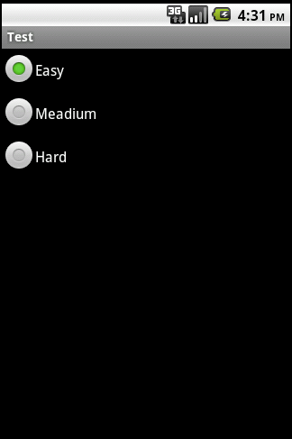
Views
RadioButton
A radio button is a two-states button that can be either checked or unchecked
  Contrary to checkbox, only one button by radio group can be checked
<RadioGroup
android:layout_width="match_parent"
android:layout_height="match_parent"
android:id="@+id/radio_group"
>
<RadioButton
android:layout_width="match_parent"
android:layout_height="wrap_content"
android:text="Easy"
/>
...
</RadioGroup>
Notes:
[Title of the course]
Nov 8, 2008
Copyright © 2004-2005 NameOfTheOrganization. All rights reserved.
22

Slide 23
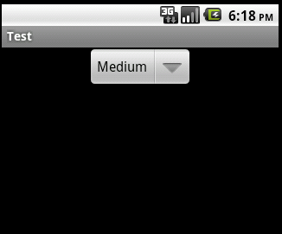
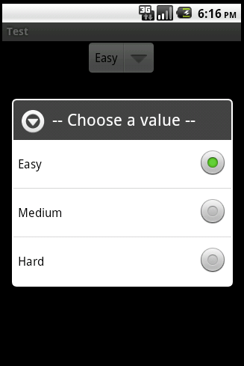
Views
Spinner
A spinner is the Android version of the combo box
<Spinner
android:id="@+id/spinner”
android:layout_width="match_parent"
android:layout_height="wrap_content”
android:prompt="@string/planet_prompt”
/>
Notes:
[Title of the course]
Nov 8, 2008
Copyright © 2004-2005 NameOfTheOrganization. All rights reserved.
23

Slide 24
Views
Spinner : Adapter
To set spinner options, you need to use a ListAdapter object
String[] values = { "Easy", "Medium", "Hard" };
ListAdapter adapter =
new ArrayAdapter<String>(this,
android.R.layout.simple_spinner_item, values);
adapter.setDropDownViewResource(
android.R.layout.simple_spinner_dropdown_item);
Spinner spinner = (Spinner) findViewById(R.id.spinner);
spinner.setAdapter(adapter);
Notes:
[Title of the course]
Nov 8, 2008
Copyright © 2004-2005 NameOfTheOrganization. All rights reserved.
24

Slide 25
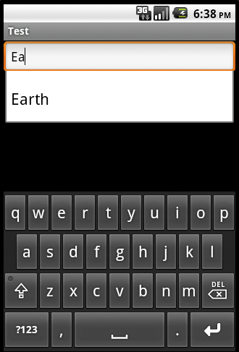
Views
AutoCompleteTextView
An editable text view that shows completion suggestions automatically while the user is typing
<AutoCompleteTextView
android:id="@+id/autocomplete_planet”
android:layout_width="match_parent"
android:layout_height="wrap_content”
/>
Notes:
[Title of the course]
Nov 8, 2008
Copyright © 2004-2005 NameOfTheOrganization. All rights reserved.
25

Slide 26
Views
AutoCompleteTextView : Adapter
To set AutoCompleteTextView options, you need to use a ListAdapter object again
String[] values = { ”Mercury”,”Venus”,”Earth”,”Mars" };
ListAdapter adapter =
new ArrayAdapter<String>(this, android.R.layout.simple_dropdown_item_1line,
values);
AutoCompleteTextView textView = (AutoCompleteTextView findViewById(R.id.autocomplete_planet);
textView.setAdapter(adapter);
Notes:
[Title of the course]
Nov 8, 2008
Copyright © 2004-2005 NameOfTheOrganization. All rights reserved.
26

Slide 27
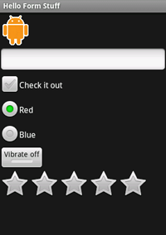
Views
RatingBar
A RatingBar is a component which represent a rating in stars
Two special attributes :
  numStars : the number of stars to display
  stepSize : the number equivalent to one star
<RatingBar
android:id="@+id/rating_bar”
android:layout_width=”wrap_content”
android:layout_height="wrap_content”
android:numStars="5”
android:stepSize="1.0"
/>
Notes:
[Title of the course]
Nov 8, 2008
Copyright © 2004-2005 NameOfTheOrganization. All rights reserved.
27

Slide 28
Views
Button
Represents a push-button widget
Push-buttons can be pressed, or clicked, by the user to perform an action
<Button
android:id="@+id/my_button”
android:layout_width=”wrap_content”
android:layout_height="wrap_content”
android:text=“@string/button_text”
/>
Notes:
[Title of the course]
Nov 8, 2008
Copyright © 2004-2005 NameOfTheOrganization. All rights reserved.
28

Slide 29
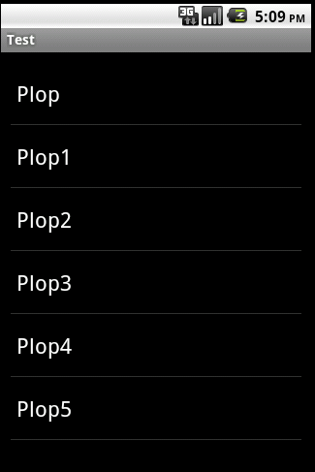
Views
ListView
A view that shows items in a vertically scrolling list
<ListView
android:id="@+id/my_list_view”
android:layout_width="match_parent"
android:layout_height="match_parent"
/>
Notes:
[Title of the course]
Nov 8, 2008
Copyright © 2004-2005 NameOfTheOrganization. All rights reserved.
29

Slide 30
Views
ListView : Adapter
To populate the list, you need to use an ListAdapter object again
ListView listView =
(ListView) findViewById(R.id.my_list_view);
Cursor cursor = new PersonDao(this).getAllPersons();
ListAdapter adapter = new SimpleCursorAdapter(this,
android.R.layout.simple_list_item_1,
cursor, new String[] { "name" },
new int[] { android.R.id.text1 });
listView.setAdapter(adapter);
Notes:
[Title of the course]
Nov 8, 2008
Copyright © 2004-2005 NameOfTheOrganization. All rights reserved.
30

Slide 31
Views
More about ListAdapter…
The bridge between a component and the data that backs the list
The most used concrete subclasses are :
  ArrayAdapter
    Adapter to map object arrays or object lists to a view
  SimpleCursorAdapter
    Adapter to map columns of a cursor to a view
    We’ll see more about curser later…
Constructors of these classes take a resource id :
  The layout to apply to the item of the view
    You can use one of proposed by the SDK
    You can define your own layout
Remember : android.R ≠ R
Notes:
[Title of the course]
Nov 8, 2008
Copyright © 2004-2005 NameOfTheOrganization. All rights reserved.
31

Slide 32


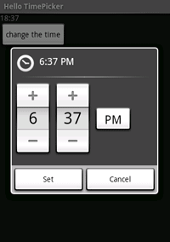
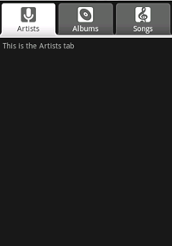

Views
Other views
Now you understand the principle
Go to see the Android Documentation for more information
You will see many more views :
  ImageView
  WebView
  GridView
  DatePicker
  ProgressBar
  ToggleButton
  VideoView
  …
Notes:
[Title of the course]
Nov 8, 2008
Copyright © 2004-2005 NameOfTheOrganization. All rights reserved.
32

Slide 33
Views
Switch to XML view
Android Studio Layout Editor
Theme
Layout editor builds
component layouts
using visual
techniques
Theme and version
settings provide a
preview capability
Easy to switch
between XML and
visual modes
Some things are
easier in the XML
view
Android API version
Widget
palette
Properties
Component
Tree
Notes:
[Title of the course]
Nov 8, 2008
Copyright © 2004-2005 NameOfTheOrganization. All rights reserved.
33

Slide 34
Questions ?

Slide 35
Views
Exercise (1/3)
We’re going to design the user interface of our application !
Your activity layout file have to define :
  A vertical LinearLayout containing :
    A horizontal LinearLayout containing :
      A TextField to enter new quotes
      A Button to create new quotes
Notes:
[Title of the course]
Nov 8, 2008
Copyright © 2004-2005 NameOfTheOrganization. All rights reserved.
35

Slide 36
Views
Exercise (2/3)
Modify the addQuote(…) method :
  After add your quote in the ArrayList :
    Create a TextView object
    Set the quote string as text of it
    Define a different background-color if the ArrayList size is odd or even
    Add the TextView to the vertical LinearLayout
Notes:
[Title of the course]
Nov 8, 2008
Copyright © 2004-2005 NameOfTheOrganization. All rights reserved.
36

Slide 37
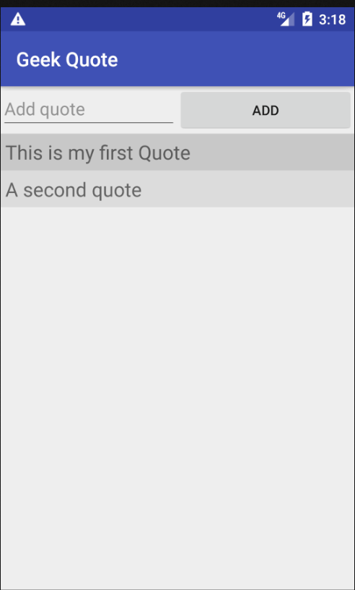
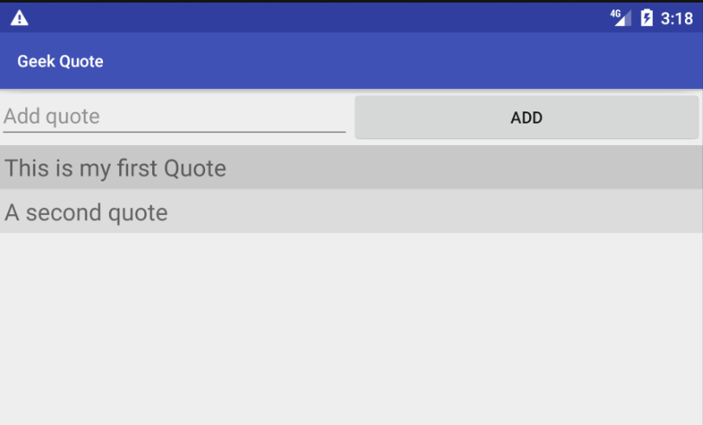
Views
Exercise (3/3)
You should get something like that :
Notes:
[Title of the course]
Nov 8, 2008
Copyright © 2004-2005 NameOfTheOrganization. All rights reserved.
37

Slide 38
Events
Android Development

Slide 39
Events
Presentation
With Android, all user actions are events
  Click
  Long click
  Key pressed
  Item selected
  …
You can link behaviors to this events
The interception mechanism based on the Listener notion
  As with Swing !
Notes:
[Title of the course]
Nov 8, 2008
Copyright © 2004-2005 NameOfTheOrganization. All rights reserved.
39

Slide 40
Events
Click Event
To add a listener to a click event on a view :
  setOnClickListener(View.OnClickListener)
OnClickListener is an inner interface of the View class
You have three possibilities :
  Make your activity implements it
  Create a new class implementing it
  Create an anonymous class
Notes:
[Title of the course]
Nov 8, 2008
Copyright © 2004-2005 NameOfTheOrganization. All rights reserved.
40

Slide 41
Events
Click Event
First solution :
public class MyActivity extends Activity
implements View.OnClickListener {
protected void onCreate(Bundle savedInstanceState) {
super.onCreate(savedInstanceState);
Button button = (Button) findViewById(R.id.my_button);
button.setOnClickListener(this);
}
public void onClick(View view) {
// Display a notification popup during 1 second.
Toast.makeText(this, "Button clicked !", 1000).show();
}
}
Notes:
[Title of the course]
Nov 8, 2008
Copyright © 2004-2005 NameOfTheOrganization. All rights reserved.
41

Slide 42
Events
Click Event
Second solution :
public class MyActivity extends Activity {
protected void onCreate(Bundle savedInstanceState) {
super.onCreate(savedInstanceState);
Button button = (Button) findViewById(R.id.my_button);
button.setOnClickListener(new ButtonClickListener());
}
}
public class ButtonClickListener
implements View.OnClickListener {
public void onClick(View view) {
// Display a notification popup during 1 second.
Toast.makeText(this, "Button clicked !", 1000).show();
}
}
Notes:
[Title of the course]
Nov 8, 2008
Copyright © 2004-2005 NameOfTheOrganization. All rights reserved.
42

Slide 43
Events
Click Event
Third solution :
public class MyActivity extends Activity {
protected void onCreate(Bundle savedInstanceState) {
super.onCreate(savedInstanceState);
Button button = (Button) findViewById(R.id.my_button);
button.setOnClickListener(new View.OnClickListener() {
public void onClick(View view) {
// Display a notification popup during 1 second.
Toast.makeText(MyActivity.this, “Clicked!", 1000).show();
}
});
}
}
Notes:
[Title of the course]
Nov 8, 2008
Copyright © 2004-2005 NameOfTheOrganization. All rights reserved.
43

Slide 44
Events
Other Events
All events are based on the same principle
Some have to return if the event has been consumed
  If true, the event does not fire other listeners
EditText editText = (EditText) findViewById(R.id.my_text);
editText.setOnTouchListener(new View.OnTouchListener() {
public boolean onTouch(View view, MotionEvent e) {
Toast.makeText(MyActivity.this, "Touch!", 1000)
.show();
return true;
// True means the listener has consumed the event.
}
});
Notes:
[Title of the course]
Nov 8, 2008
Copyright © 2004-2005 NameOfTheOrganization. All rights reserved.
44

Slide 45
Questions ?

Slide 46
Binding Data
Android Development

Slide 47
Binding Data
Displaying Application Data
Android provides an elegant method for linking Views to underlying data
  Adapters and AdapterViews
Adapter makes data available to an AdapterView
  Provides a consistent interface
  Regardless of the underlying data source
Adapter
AdapterView
View Item
Content
Provider
Array
Other
Notes:
[Title of the course]
Nov 8, 2008
Copyright © 2004-2005 NameOfTheOrganization. All rights reserved.
47

Slide 48
Binding Data
AdapterView
Android provides many AdapterView subclasses
Each provides a different way of visually organizing items
The items are Views returned from the Adapter
  TextView
  ImageView
  ViewGroup (layout) of any complexity
…
Locale | Description | Adapter class
ListView | Displays items in a vertically scrolling list | ListAdapter
GridView | A two-dimensional scrolling grid view | ListAdapter
Spinner | Expanding list view; displays single selected item until activated | Adapter
Gallery | Horizontally scrolling list, typically of images | Adapter
Notes:
[Title of the course]
Nov 8, 2008
Copyright © 2004-2005 NameOfTheOrganization. All rights reserved.
48

Slide 49
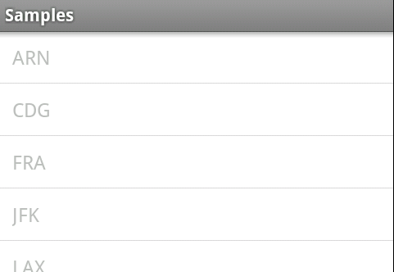
Binding Data
Displaying List Data
To display list data
  1 - Define an Activity with a view containing a ListView
  2 - Define a View resource (layout) to display
  items in the list
  3 - Create an Adapter for the list data
  4 - Associate the Adapter with the ListView
  5 - Optionally, handle ListView click events
Our example uses an ArrayAdapter
Populates list items with weather station codes loaded from an ArrayList of Strings
Adapters for databases and content providers are covered later
Notes:
[Title of the course]
Nov 8, 2008
Copyright © 2004-2005 NameOfTheOrganization. All rights reserved.
49

Slide 50
Binding Data
Step 1
Activity sets layout using setContentView()
Layout contains a ListView
  protected void onCreate(Bundle savedInstanceState) {
  super.onCreate(savedInstanceState);
  setContentView(R.layout.stations_list);
  //1. Create an Activity which extends ListActivity
<LinearLayout …
<ListView
android:layout_width="match_parent"
android:layout_height="match_parent"
android:id="@+id/listView"
android:layout_weight="1" />
</LinearLayout>
Notes:
[Title of the course]
Nov 8, 2008
Copyright © 2004-2005 NameOfTheOrganization. All rights reserved.
50

Slide 51
Binding Data
Step 2
Define a suitable View item layout to display the items in the list
The Adapter will automatically populate this with data from the ArrayList of weather stations
Alternatively, use a built-in layout for displaying list item data
<TextView xmlns:android="http://schemas.android.com/apk/res/android"
android:id="@+id/text1"
android:layout_width="match_parent"
android:layout_height="match_parent"
…>
</TextView>
android.R.layout.simple_list_item_1
android.R.layout.simple_list_item_2
android.R.layout.simple_list_item_single_choice
Notes:
[Title of the course]
Nov 8, 2008
Copyright © 2004-2005 NameOfTheOrganization. All rights reserved.
51

Slide 52
Binding Data
Step 3
In the onCreate() method of the ListActivity
  Obtain a reference to the data for the list
    Our ArrayList of weather station strings
  Create an ArrayAdapter
ArrayList<String> weatherStationArrayList = getListData();
ArrayAdapter<String> stationListAdapter =
new ArrayAdapter<String>(
this,
R.layout.list_item,
// The array list to be displayed
weatherStationArrayList);
Notes:
[Title of the course]
Nov 8, 2008
Copyright © 2004-2005 NameOfTheOrganization. All rights reserved.
52

Slide 53
Binding Data
Step 4
Finally, associate the adapter with the ListView
//4. Associate the adapter with the list
ListView mList;
…
mList = (ListView) findViewById(R.id.listView);
mList.setAdapter(stationListAdapter);
Notes:
[Title of the course]
Nov 8, 2008
Copyright © 2004-2005 NameOfTheOrganization. All rights reserved.
53

Slide 54
Binding Data
Step 5
Clicks on list items supported by AdapterView.OnItemClickListener
Single method onItemClick
Usel.getItemAtPosition(position); to get position
public void onItemClick(AdapterView<?> parent,
View view,
int position,
long id)
Parameter | Description
parent | The AdapterView where the click happened
view | The view that was clicked within the ListView
position | The position of the view in the list
id | The row ID of the item that was clicked
Notes:
[Title of the course]
Nov 8, 2008
Copyright © 2004-2005 NameOfTheOrganization. All rights reserved.
54

Slide 55
Binding Data
List Click Handling
public class StationsActivity extends Activity
implements AdapterView.OnItemClickListener
protected void onCreate(Bundle savedInstanceState) {
mList = (ListView) findViewById(R.id.listView);
mList.setOnItemClickListener(this);
}
public void onItemClick(AdapterView<?> theList,
View view, int position, long id) {
String station = (String)theList.getItemAtPosition(position);
}
Notes:
[Title of the course]
Nov 8, 2008
Copyright © 2004-2005 NameOfTheOrganization. All rights reserved.
55

Slide 56
Questions ?

Slide 57
Binding Data
Exercise (1/5)
Now you know how to use listeners :
  When the user click on the add quote button :
    Create a new Quote object and add it to the ArrayList and to the screen
    Empty the text field
Notes:
[Title of the course]
Nov 8, 2008
Copyright © 2004-2005 NameOfTheOrganization. All rights reserved.
57

Slide 58
Binding Data
Exercise (2/5)
We’re going to use a ListView instead of create TextViews in our code
Modify the layout and add a ListView component
Create an ArrayAdapter object to link our ArrayList and the ListView
  Don’t forget to override the toString() method of Quote class
    ArrayAdapter call this method to display elements in the ListView
Notes:
[Title of the course]
Nov 8, 2008
Copyright © 2004-2005 NameOfTheOrganization. All rights reserved.
58

Slide 59
Binding Data
Exercise (3/5)
Use toString() method to display something to the user is not a good practice…
  Create your own ListAdapter is better !
Create a class named QuoteListAdapter which :
  Extends BaseAdapter class
Notes:
[Title of the course]
Nov 8, 2008
Copyright © 2004-2005 NameOfTheOrganization. All rights reserved.
59

Slide 60
Binding Data
Exercise (4/5)
Create a class named QuoteListAdapter which :
  Override the getView(…) method :
    Look at the ArrayAdapter code of that method :
    https://developer.android.com/reference/android/widget/ArrayAdapter
    Make your own to :
      Avoid to use toString() method
      Change background color according to parity
Notes:
[Title of the course]
Nov 8, 2008
Copyright © 2004-2005 NameOfTheOrganization. All rights reserved.
60

Slide 61
Binding Data
Exercise (5/5)
You should get something like that :
Notes:
[Title of the course]
Nov 8, 2008
Copyright © 2004-2005 NameOfTheOrganization. All rights reserved.
61

Slide 62
Questions ?

Slide 63

The end
Thanks for your attention

